Slide 1
Designing a Page Layout
Cascading Style Sheets

Slide 2
Objectives
Create
Create a reset style sheet
Explore
Explore page layout designs
Center
Center a block element
Create
Create a floating element
Clear
Clear a floating layout
Prevent
Prevent container collapse
Use
Use CSS grid styles

Slide 3

Objectives
Define a grid layout
Place items within a grid
Work with grid areas
Explore positioning styles
Work with relative positioning
Work with absolute positioning
Work with overflow content

Slide 4
Introducing the display Style
Two classifications of HTML elements
Block elements: such as paragraphs or headings
Inline elements: such as emphasized text or inline images
Define the display style for any page using the display property:
display: type;
where type defines the display type

Slide 5
Introducing the display Style
Display Value | Appearance
block | Displayed as a block
table | Displayed as a web table
inline | Displayed inline within a block
inline-block | Treated as a block placed inline within another block
run-in | Displayed as a block unless its next sibling is also a block, in which case, it is displayed inline, essentially combining the two blocks into one
inherit | Inherits the display property of the parent element
list-item | Displayed as a list item along with a bullet marker
none | Prevented from displaying, removing it from the rendered page

Slide 6
Creating a Reset Style Sheet
Reset style sheet supersedes a browser’s default styles and provides a consistent starting point for page design
The first style rule in a sheet is the display property used to display HTML5 structural elements as blocks
Premade reset style sheets are freely available on the web that contain many style rules used to reconcile the various differences between browsers and devices

Slide 7
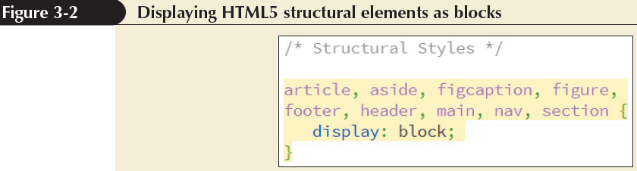
Creating a Reset Style Sheet

Slide 8
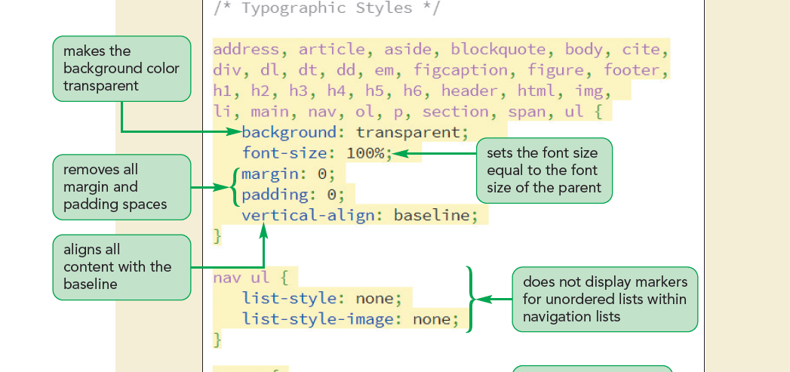
Creating a Reset Style Sheet

Slide 9
Exploring Page Layout Designs
Web page layouts fall into three categories
Fixed layout – Size of the page and page elements are fixed, usually using pixels as the unit of measure
Fluid layout – The width of the page elements are set as a percent of the available screen width
Elastic layout – Images and text are always sized in proportion to each other in em units
Responsive design – The layout and design of a page changes in response to the device that is rendering it

Slide 10
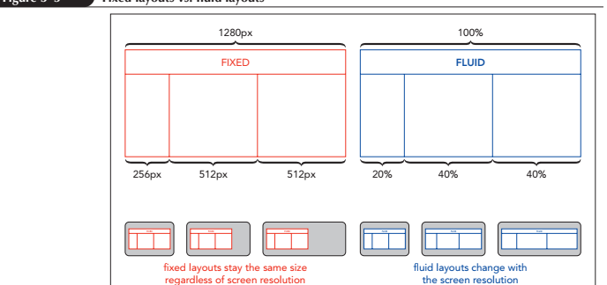
Exploring Page Layout Designs

Slide 11
Working with Width and Height
The width and height of an element are set using the following properties:
width: value;
height: value;
where value is the width or height using one of the CSS units of measurement or as a percentage of the width or height of the parent element

Slide 12
Setting Maximum and Minimum Dimensions
Set
Set limits on the width or height of a block element by applying the following properties:
Value
min-width: value;
Value
min-height: value;
Value
max-width: value;
Value
max-height: value;
Value
where value is a length expressed in one of the CSS units of measure (usually pixels to match the display device measurement unit)

Slide 13
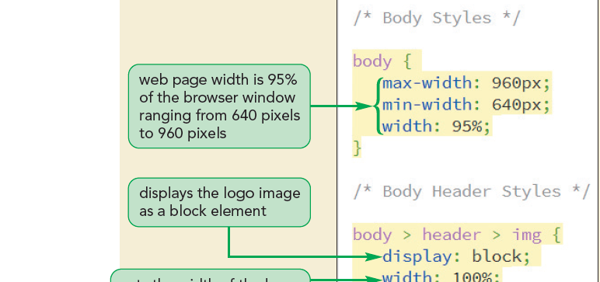
Setting Maximum and Minimum Dimensions

Slide 14
Centering a Block Element
Block elements can be centered horizontally within their parent element by setting both the left and right margins to auto
Example: center the page body within the browser window using the style rule
body {
margin-left: auto;
margin-right: auto;
}

Slide 15
Vertical Centering
Centering an element vertically can be accomplished by displaying the parent element as a table cell and setting the vertical-align property to middle
Example: to vertically center the following h1 heading within the div element:
<div>
<h1>Pandaisia Chocolates</h1>
</div>

Slide 16
Vertical Centering
Apply the style rule
div {
height: 40px;
display: table-cell;
vertical-align: middle;
}
Using this style rule, the h1 heading will be vertically centered

Slide 17
Vertical Centering
Can vertically center a single line of text within its parent element
Set text line height to be larger than font size
h1 {
font-size: 1.4em;
line-height: 2em;
}
This only works for a single line of text

Slide 18
Floating Page Content
Floating an element takes it out of position and places it along the left or right side of its parent element
To float an element, apply
float: position;
where position is none (the default), left to float the object on the left margin or right to float the object on the right margin

Slide 19
Floating Page Content
If sibling elements are floated along the same margin, they are placed alongside each other within a row
For elements to be placed within a single row, the combined width of the elements cannot exceed the total width of their parent element
Otherwise excess content will automatically wrap to a new row

Slide 20
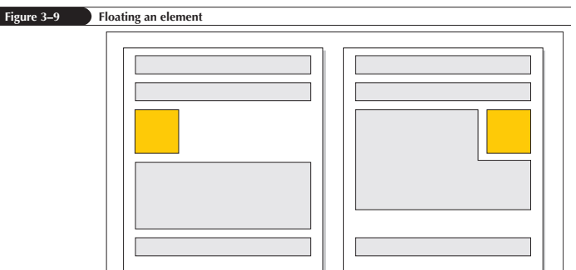
Floating Page Content

Slide 21
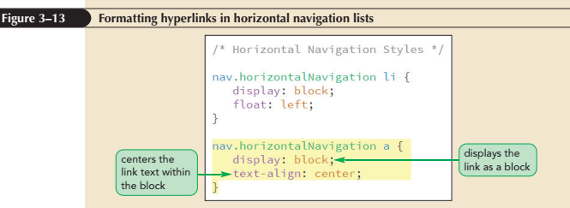
Floating Page Content

Slide 22
Clearing a Float
To ensure that an element is always displayed below floated elements, use
clear: position;
where position is left, right, both, or none

Slide 23
Clearing a Float
left – Displays the element only when the left margin is clear of floating objects
right – Displays the element only when the right margin is clear of floating objects
both – Displays the element only when both margins are clear of floats
none – Displays the element alongside any floated objects

Slide 24
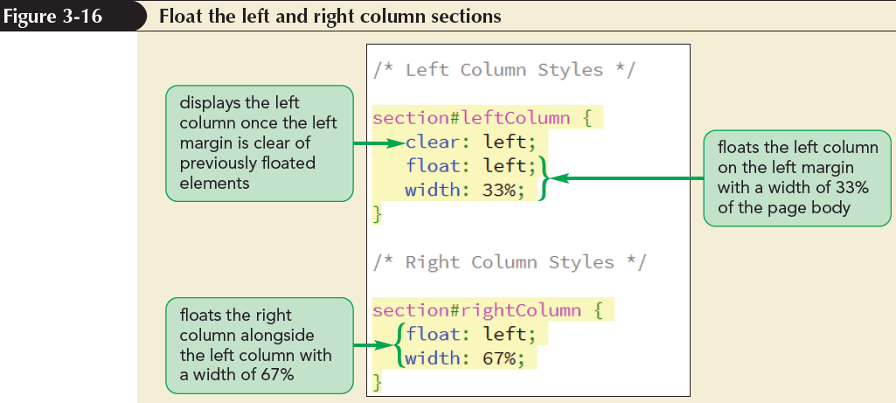
Clearing a Float

Slide 25
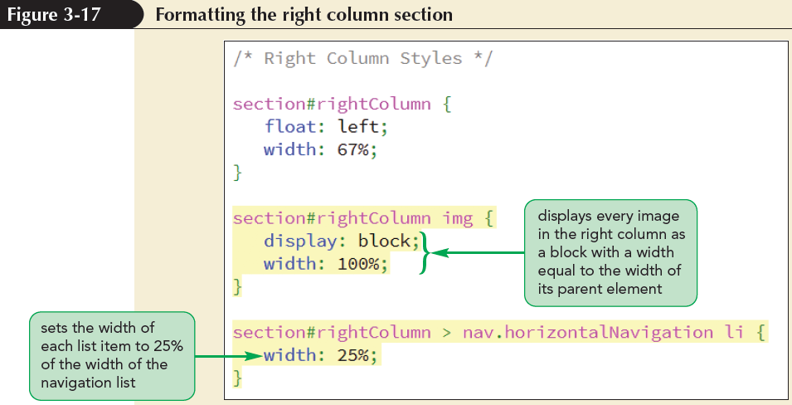
Clearing a Float

Slide 26
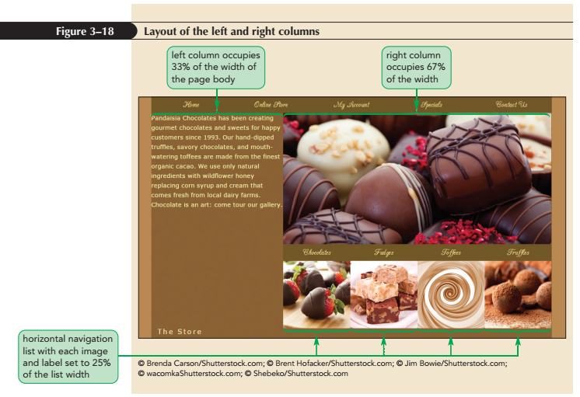
Clearing a Float

Slide 27
Refining a Floated Layout
Content box model – The width property refers to the width of an element content only
Additional space include padding or borders
Border box model – The width property is based on the sum of the content, padding, and border spaces
Additional space taken up by the padding and border is subtracted from space given to the content

Slide 28
Refining a Floated Layout
The layout model can be chosen using
box-sizing: type;
where type is content-box (the default), border-box, or inherit (to inherit the property defined for the element’s container)

Slide 29
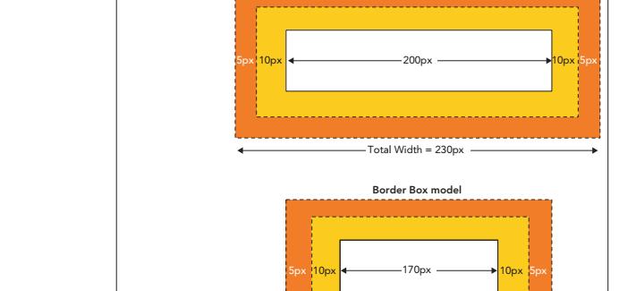
Refining a Floated Layout

Slide 30
Working with Container Collapse
Container collapse – An empty container with no content
Elements in the container are floated

Slide 31
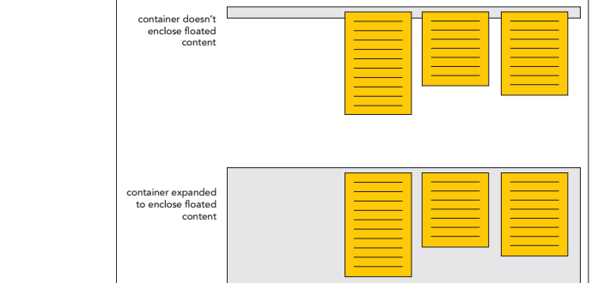
Working with Container Collapse

Slide 32
Working with Container Collapse
Use the after pseudo-element to add a placeholder element after the footer
The general style rule is
container::after {
clear: both;
content: “”;
display: table;
}
where container is the selector for the element containing floating objects

Slide 33
Working with Container Collapse
The clear property keeps the placeholder element from being inserted until both margins are clear of floats
The element itself is a web table and contains an empty text string

Slide 34
Overview of Grid-Based Layouts
In a grid layout, the page is comprised of a system of intersecting rows and columns that form a grid
The rows are based on the page content
The number of columns is based on the number that provides the most flexibility in laying out the page content
Many grid systems are based on 12 columns

Slide 35
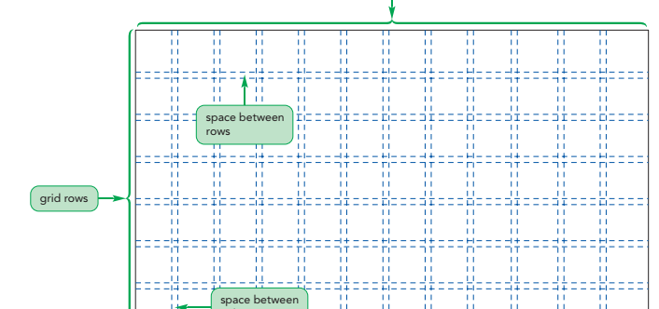
Overview of Grid-Based Layouts

Slide 36
Overview of Grid-Based Layouts
Advantages of using a grid:
Grids add order to the presentation of page content
A consistent logical design gives readers the confidence to find the information they seek
New content can be easily placed within a grid in a manner consistent with previously entered data
It is easily accessible for users with disabilities and special needs
It increases development speed with a systematic framework for the page layout

Slide 37
Fixed and Fluid Grids
Fixed grids – Every column has a fixed position
Widths of the columns and margins are specified in pixels
Fluid grids – Provides more support across different devices with different screen sizes
Column width is expressed in percentages

Slide 38
CSS Frameworks
A framework is a software package that provides a library of tools to design a website
Includes style sheets for grid layouts and built-in scripts to provide support for a variety of browsers and devices
Some popular CSS frameworks include
Bootstrap, Neat, Unsemantic, Profound Grid, HTML5 Boilerplate, Skeleton

Slide 39
Introducing CSS Grids
The CSS grid model is a set of CSS design styles used to create grid-based layouts
Each CSS grid is laid out in a set of row and column gridlines

Slide 40
Introducing CSS Grids
To reference positions within a grid, the CSS grid model numbers the gridlines in the horizontal and vertical directions
Start from the top-left corner of the grid with the row gridlines and then moving left to right with the column gridlines along the bottom
Both gridlines start with a value of “1” and increase in value down and across the grid

Slide 41
Introducing CSS Grids
Gridlines can be referenced in the reverse order starting
Start from the bottom-right corner with the first row and column gridlines in those directions are given a value of “-1”
The advantage of using both positive and negative gridline numbers
Can always reference both the first gridline (1) and the last gridline (-1) no matter the size of the grid

Slide 42
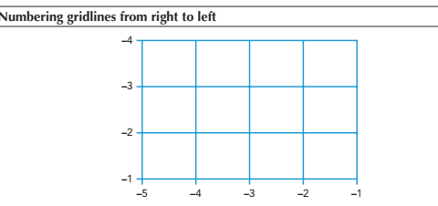
Introducing CSS Grids

Slide 43
Introducing CSS Grids
The cells that are created from the intersection of the horizontal and vertical gridlines will contain the elements from the web page
An element can be contained within a single cell or it can span several cells within a grid area
Note that grid areas must be rectangular; you cannot have an L-shaped grid area

Slide 44
Creating a CSS Grid
To create a CSS grid, first identify a page element as the grid container using the following display property:
display: grid;
The entire grid itself is considered a block-level element and thus could be floated or resized within the web page just like any other block-level element

Slide 45
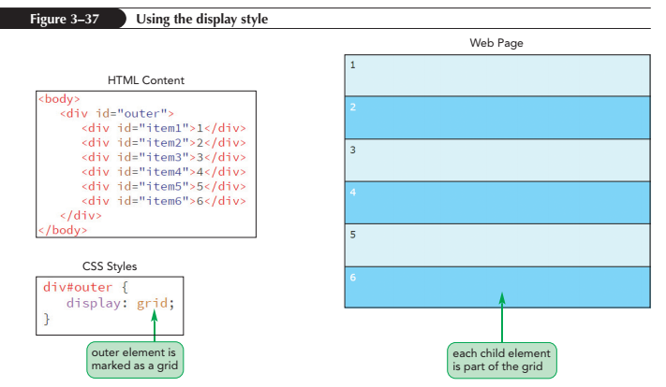
Creating a CSS Grid

Slide 46
Creating a CSS Grid
Grids can also be created as inline elements using the style:
display: inline-grid;
which creates the grid inline with other elements in the web page

Slide 47
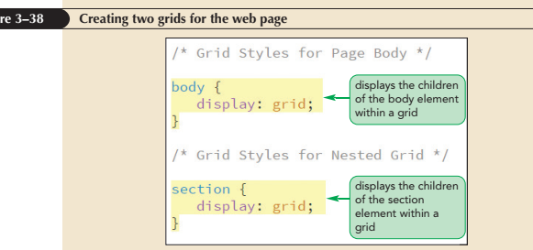
Creating a CSS Grid

Slide 48
Working with Grid Rows and Columns
To define the number and size of grid columns, use the following grid-template-columns style:
grid-template-columns: width1 width2 …;
where width1, width2, etc. is a space-separated list that defines the width of the columns or tracks within the grid

Slide 49
Working with Grid Rows and Columns
Column widths can be expressed using any CSS unit measures such as pixels, em units, and percentages
The keyword auto can be used to allow the column width to be automatically set by the browser

Slide 50
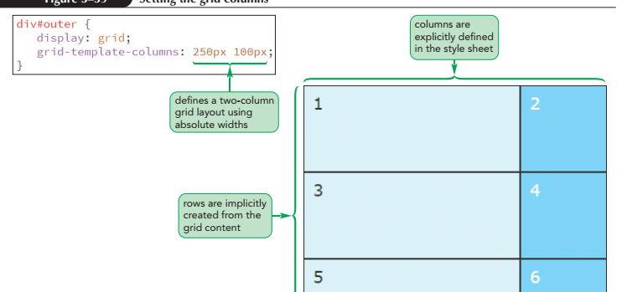
Working with Grid Rows and Columns

Slide 51
Working with Grid Rows and Columns
An explicit grid completely defines the number and size of the grid rows and columns
An implicit grid contains rows and/or columns that are generated by the browser as it populates the grid with items from the grid container
In most grid layouts, columns are explicitly defined and the browser fills out the grid rows drawn from the web page content

Slide 52
Working with Grid Rows and Columns
To explicitly define the number of rows and their height, use the following
grid-template-rows property:
grid-template-rows: height1 height2 …;
where height1, height2, etc. define the heights of the grid rows

Slide 53
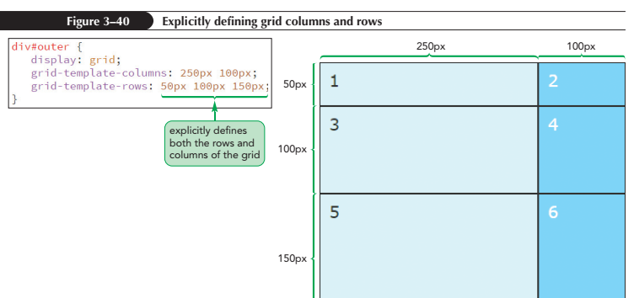
Working with Grid Rows and Columns

Slide 54
Track Sizes with Fractional Units
A grid layout can adapt to devices of various screen widths and sizes by using flexible units
A fr (fractional) unit, indicated by the unit abbreviation fr, creates grid tracks that expand or contract in size to fill available space while retaining their relative proportions to one another

Slide 55
Track Sizes with Fractional Units
Fractional units are often combined with absolute units to create grid layouts that are both fixed and flexible
The following style rule generates a grid in which the width of the first column is set to 250 pixels with the remaining space allotted to the other two columns in a proportion of 2 to 1
grid-template-columns: 250px 2fr 1fr

Slide 56
Repeating Columns and Rows
Some grid layouts involve many columns so it is difficult to specify column sizes
The layout style can be simplified by using the following repeat() function:
repeat(repeat, tracks)
where repeat is the number of repetitions of the tracks specified in tracks

Slide 57
Repeating Columns and Rows
In place of a repeat value, the keyword auto-fill can be used to fill up the grid with as many columns (or rows) that will fit within the grid container
The following style uses the auto-fill keyword to fill the grid with as many 100 pixel-wide columns that will fit within the container:
grid-template-columns: 250px repeat(auto-fill, 100px);

Slide 58
Repeating Columns and Rows
It is possible to switch between fixed and flexible track sizes using the following function
minmax(min, max)
where min is the minimum track size for a row and column and max is the maximum
Example:
grid-template-columns: repeat(auto-fill, minmax(100px, 1fr));

Slide 59
Outlining a Grid
Outlines - Lines drawn around an element, enclosing the element content, padding, and border spaces
Outline-width: value; – Specifies the width of a line
Properties of value are: thin, medium, or thick
Outline-color: color; – Specifies the color of a line
Properties of color are: CSS color name or value

Slide 60
Outlining a Grid
Outline-style: style; - Specifies the design of a line
Properties of style are: solid, double, dotted, dashed, groove, inset, ridge, or outset
Outline properties can be combined:
width style color;
where width, style, and color are the values for the line’s width, design, and color

Slide 61
Placing Items within a Grid
By default, grid items are laid out in document order going from left to right and up to down, with each item placed within a single cell
In many layouts however, it might be desirable to move items around or a have a single item occupy multiple rows and column

Slide 62
Placing Items by Row and Column
To place the article element in a grid cell located in the first row and second column of the grid, apply the following style rule:
article {
grid-row: 1;
grid-column: 2;
}

Slide 63
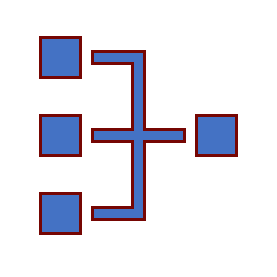
Placing Items by Row and Column
To move a grid item to a specific location within the grid, use the following grid-row and grid-column properties:
grid-row: row;
grid-column: column;
where row is the row number and column is the column number

Slide 64
Placing Items by Row and Column
To extend a grid item so that it covers multiple rows or multiple columns, include the starting and ending gridline in the style property as follows:
grid-row: start/end;
grid-column: start/end;
where start is the starting gridline and end is the ending gridline

Slide 65
Placing Items by Row and Column)
Starting and ending gridlines can be expressed in the following four properties:
grid-column-start: integer;
grid-column-end: integer;
grid-row-start: integer;
grid-row-end: integer;

Slide 66
Using the span Keyword
Another way of setting the size of a grid cell is with the span keyword
The general syntax is:
grid-row: span value;
grid-column: span value;
where value is the number of rows or columns covered by the item

Slide 67
Using the span Keyword
To specify both the location and the size of the item, include the starting gridline in the style rule
Example:
article {
grid-row: 1/span 2;
grid-column: 4/span 3;
}

Slide 68
Placing Grid Items by Area
In the grid areas approach to layout you identify sections of the grid with item names, creating a textual representation of the layout

Slide 69
Placing Grid Items by Area
To create a textual representation in a style sheet, use the following grid-template-areas property:
grid-template-areas: "row1"
"row2"
…;
where row1, row2, etc. are text strings containing the names of the areas for each row

Slide 70
Placing Grid Items by Area
To assign elements to grid areas, use the following grid-area property:
grid-area: area;
where area is the name of an area defined in the grid-template-areas property

Slide 71
Placing Grid Items by Area
The grid-area property can be used as a shorthand to place and size grid items using gridline numbers
The general syntax is:
grid-area: row-start/col-start/row-end/col-end;
where row-start, col-start, row-end, and col-end are the starting and ending gridline numbers from the grid’s rows and columns

Slide 72
Defining the Grid Gap
Another part of grid layout is defining the space between items in a grid
The gap size is defined using the following grid-gap property:
grid-gap: row column;
where row is the internal space between grid rows and column is the internal space between grid columns

Slide 73
Defining the Grid Gap
Grid
Grid gaps for rows and columns can also be set using the following properties:
Value
grid-column-gap: value;
Grid
grid-row-gap: value;
Value
where value is the size of the gap in one of the CSS units of measure
Gap
Gap size setting is applied only to the interior space between the grid items

Slide 74
Managing Space within a Grid
The content within the grid cell can be positioned using the align-items and justify-items properties
The align-items property sets the vertical placement of the content
The justify-items property sets the horizontal placement
The syntax of both properties is:
align-items: placement;
justify-items: placement;

Slide 75
Managing Space within a Grid
where placement is:
stretch to expand the content between the top/bottom or left/right edges, removing any spacing between the content and the cell border (the default)
start to position the content with the top or left edge of the cell
end to position the content with the bottom or right edge of the cell
center to center the content vertically or horizontally within the cell

Slide 76
Alignment for a Single Grid Cell
To align and justify only one cell, apply the align-self and justify-self properties to the content within the grid cell
Example
article {
align-self: center;
justify-self: center;
}

Slide 77
Aligning the Grid
To modify grid position use the align-content and justify-content properties:
align-content: placement;
justify-content: placement;
Where placement is:
start to position the grid with the top or left edge of the container (the default)
end to position the grid with the bottom or right edge of the container

Slide 78
Aligning the Grid
center to center the grid vertically or horizontally within the container
space-around to insert an even amount of space between each grid item with no space at the far ends
space-between to insert an even amount of space between each grid item, with no space at the far ends
space-evenly to insert an even amount of space between each grid item, including the far ends

Slide 79
The CSS Positioning Styles
To place an element at a specific position within its container, use
position: type;
top: value;
right: value;
bottom: value;
left: value;
where type indicates the kind of positioning applied to the element and top, right, bottom, and left properties indicate the coordinates of the element

Slide 80
The CSS Positioning Styles
Static positioning – The element is placed where it would have fallen naturally within the flow of the document
Relative positioning – The element is moved out of its normal position in the document flow
Absolute positioning – The element is placed at specific coordinates within containers

Slide 81
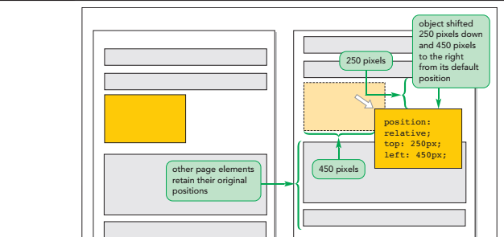
The CSS Positioning Styles

Slide 82
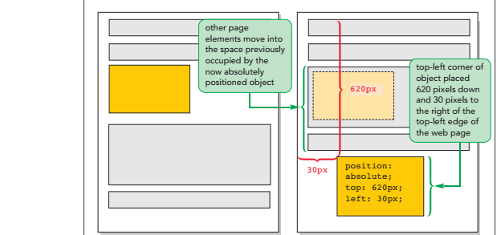
The CSS Positioning Styles

Slide 83
Fixed and Inherited Positioning
Fixed positioning – Fixes an object within a browser window to avoids its movement
Inherited positioning – Allows an element to inherit the position value of its parent element

Slide 84
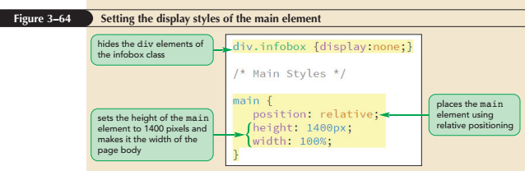
Using the Positioning Styles

Slide 85
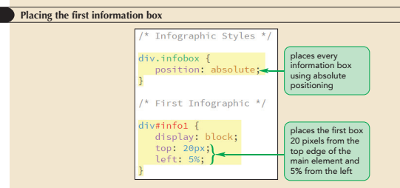
Using the Positioning Styles

Slide 86
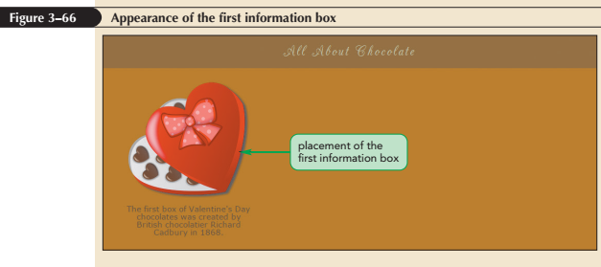
Using the Positioning Styles

Slide 87
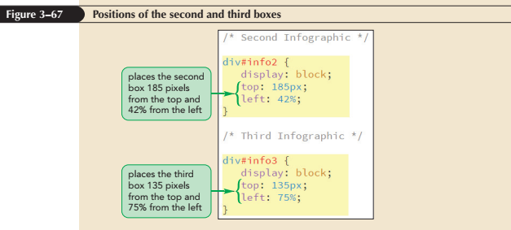
Using the Positioning Styles

Slide 88
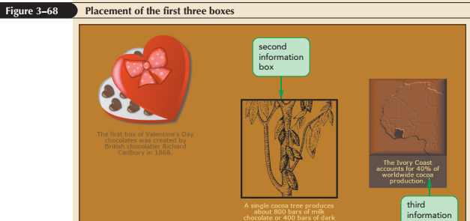
Using the Positioning Styles

Slide 89
Handling Overflow
Overflow property – Controls a browser that handles excess content
overflow: type;
where type is visible (the default), hidden, scroll, or auto
visible – Instructs browsers to increase the height of an element to fit overflow contents

Slide 90
Handling Overflow
hidden – Keeps an element at the specified height and width, but cuts off excess content
scroll – Keeps an element at the specified dimensions, but adds horizontal and vertical scroll bars
auto – Keeps an element at the specified size, adding scroll bars when they are needed

Slide 91
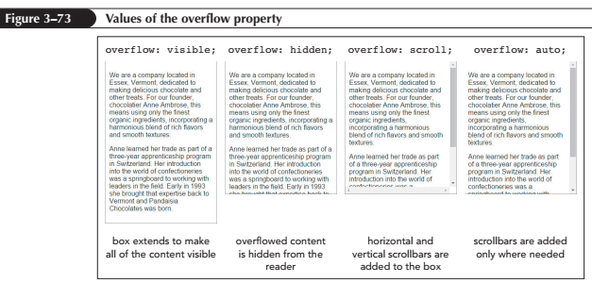
Handling Overflow

Slide 92
Handling Overflow
CSS3 provides the overflow-x and overflow-y properties to handle overflow specially in the horizontal and vertical directions

Slide 93
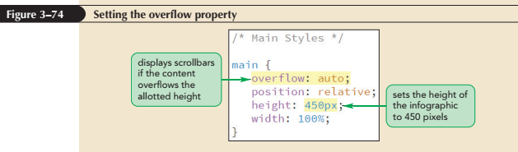
Handling Overflow

Slide 94
Clipping an Element
The clip property defines a rectangular region through which an element’s content can be viewed
Anything that lies outside the boundary of the rectangle is hidden
The clip property syntax is
clip: rect(top, right, bottom, left);
where top, right, bottom, and left define the coordinates of the clipping rectangle

Slide 95
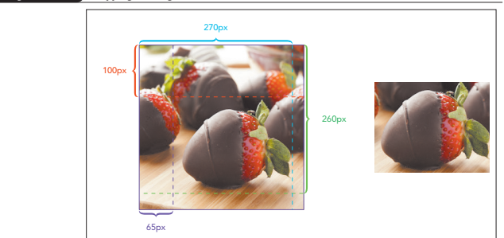
Clipping an Element

Slide 96
Stacking Elements
By default, elements that are loaded later by a browser are displayed on top of elements that are loaded earlier
To specify different stacking order, use the following z-index property:
z-index: value;
where value is a positive or negative integer, or the keyword auto

Slide 97
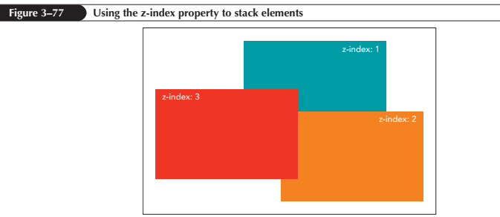
Stacking Elements

Slide 98
Stacking Elements
The z-index property works only for elements that are placed with absolute positioning
An element’s z-index value determines its position relative only to other elements that share a common parent

Slide 99
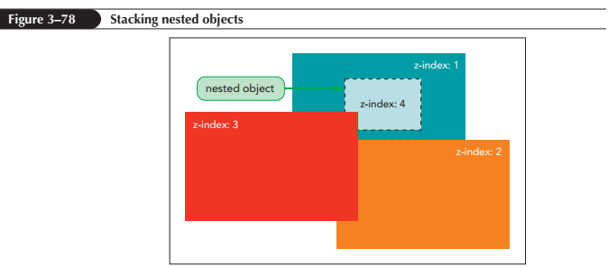
Stacking Elements

